Slide 1
A Threshold-Based Segmentation Method for Quantification of COVID-19 Lung Infection Azrin Khan

Slide 2
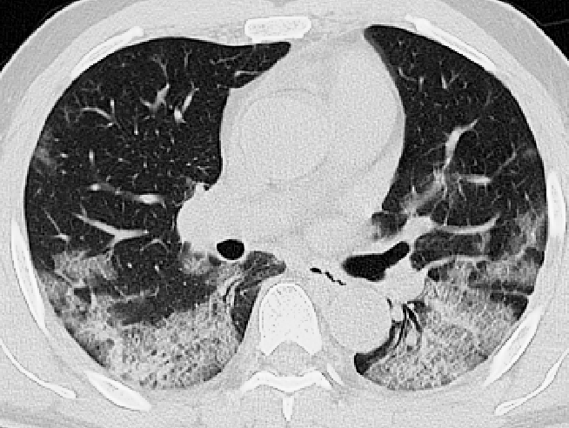
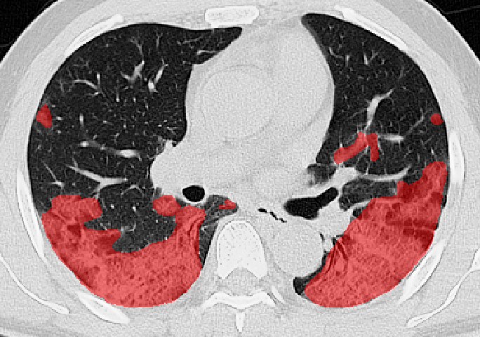
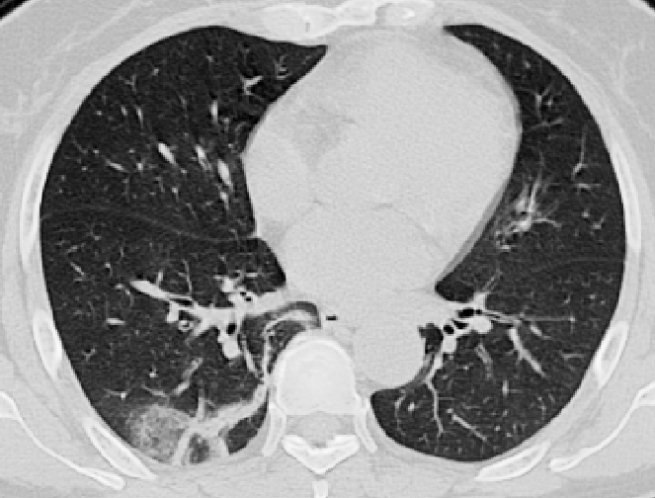
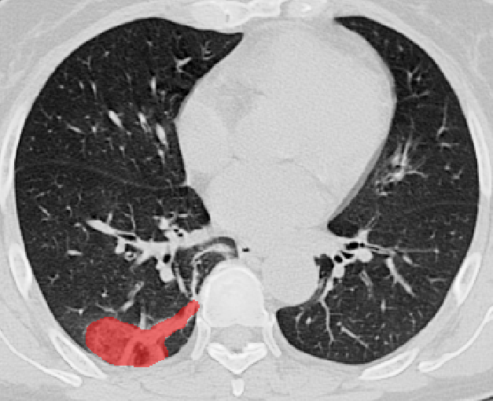
CT Scans & Segmentations
CT Image
Segmented Infection
Infection Mask
Ma Jun, Ge Cheng, Wang Yixin, An Xingle, Gao Jiantao, Yu Ziqi, … He Jian. (2020). COVID-19 CT Lung and Infection Segmentation Dataset (Version 1.0) [Data set]. Zenodo.
Notes:
In this method, I'm extracting infected regions from COVID-19 positive patient CT scans. And CT scans are used because it is one of the most effective and functional way for detecting the severity and the degree of lung inflammation likely to be associated with COVID-19, also because these scans provide a detailed picture of the lungs. Shown in this diagram, as was previously spoken about, some of the most common COVID lung features are ground-glass opacities, crazy-paving patterns, and consolidation. Segmentations of these regions are important because its size & position may relate to COVID-19 and because these CT findings are not specific to COVID-19 but can also be found in other respiratory diseases. So, we extract these regions using image thresholding.

Slide 3
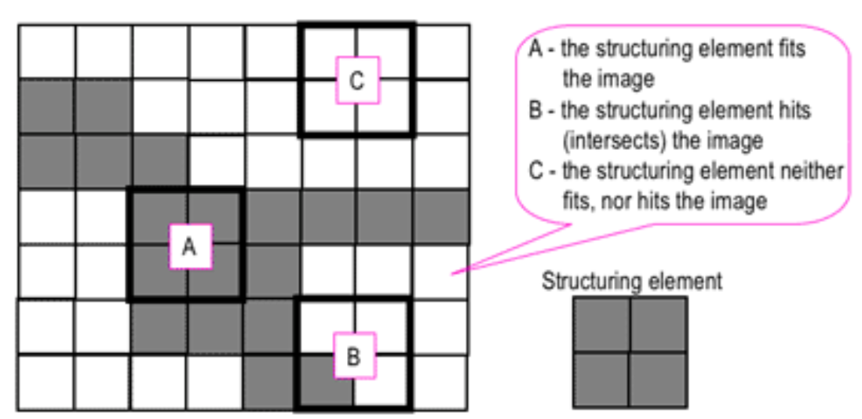
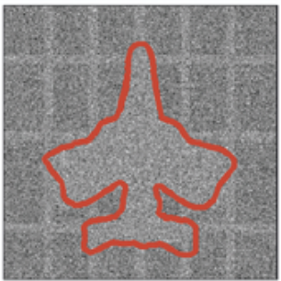
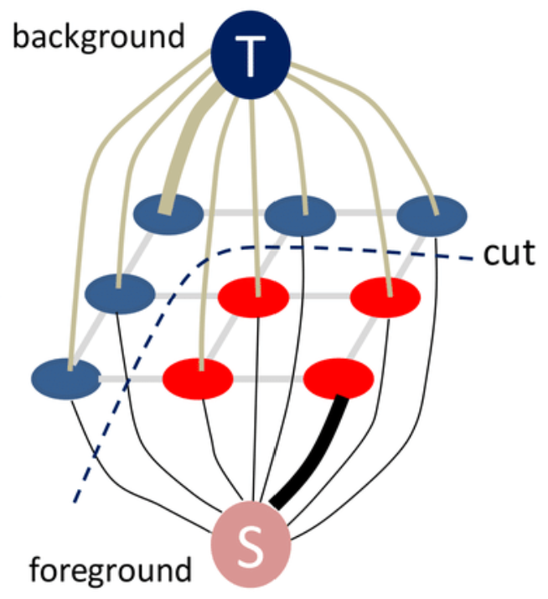
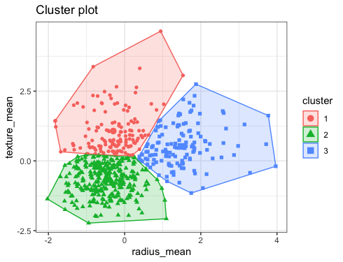
Segmentation Methods
Morphological Methods
Shape Based Methods
Region Based Methods
Thresholding
Machine Learning Based Methods
Clustering
Graph Based Methods
Image Segmentation Method

Slide 4
Image Binarization using thresholding
Lung CT Image
Pixel Intensity Histogram
Notes:
In this method, I'm extracting infected regions from COVID-19 positive patient CT scans. And CT scans are used because it is one of the most effective and functional way for detecting the severity and the degree of lung inflammation likely to be associated with COVID-19, also because these scans provide a detailed picture of the lungs. Shown in this diagram, as was previously spoken about, some of the most common COVID lung features are ground-glass opacities, crazy-paving patterns, and consolidation. Segmentations of these regions are important because its size & position may relate to COVID-19 and because these CT findings are not specific to COVID-19 but can also be found in other respiratory diseases. So, we extract these regions using image thresholding.

Slide 5
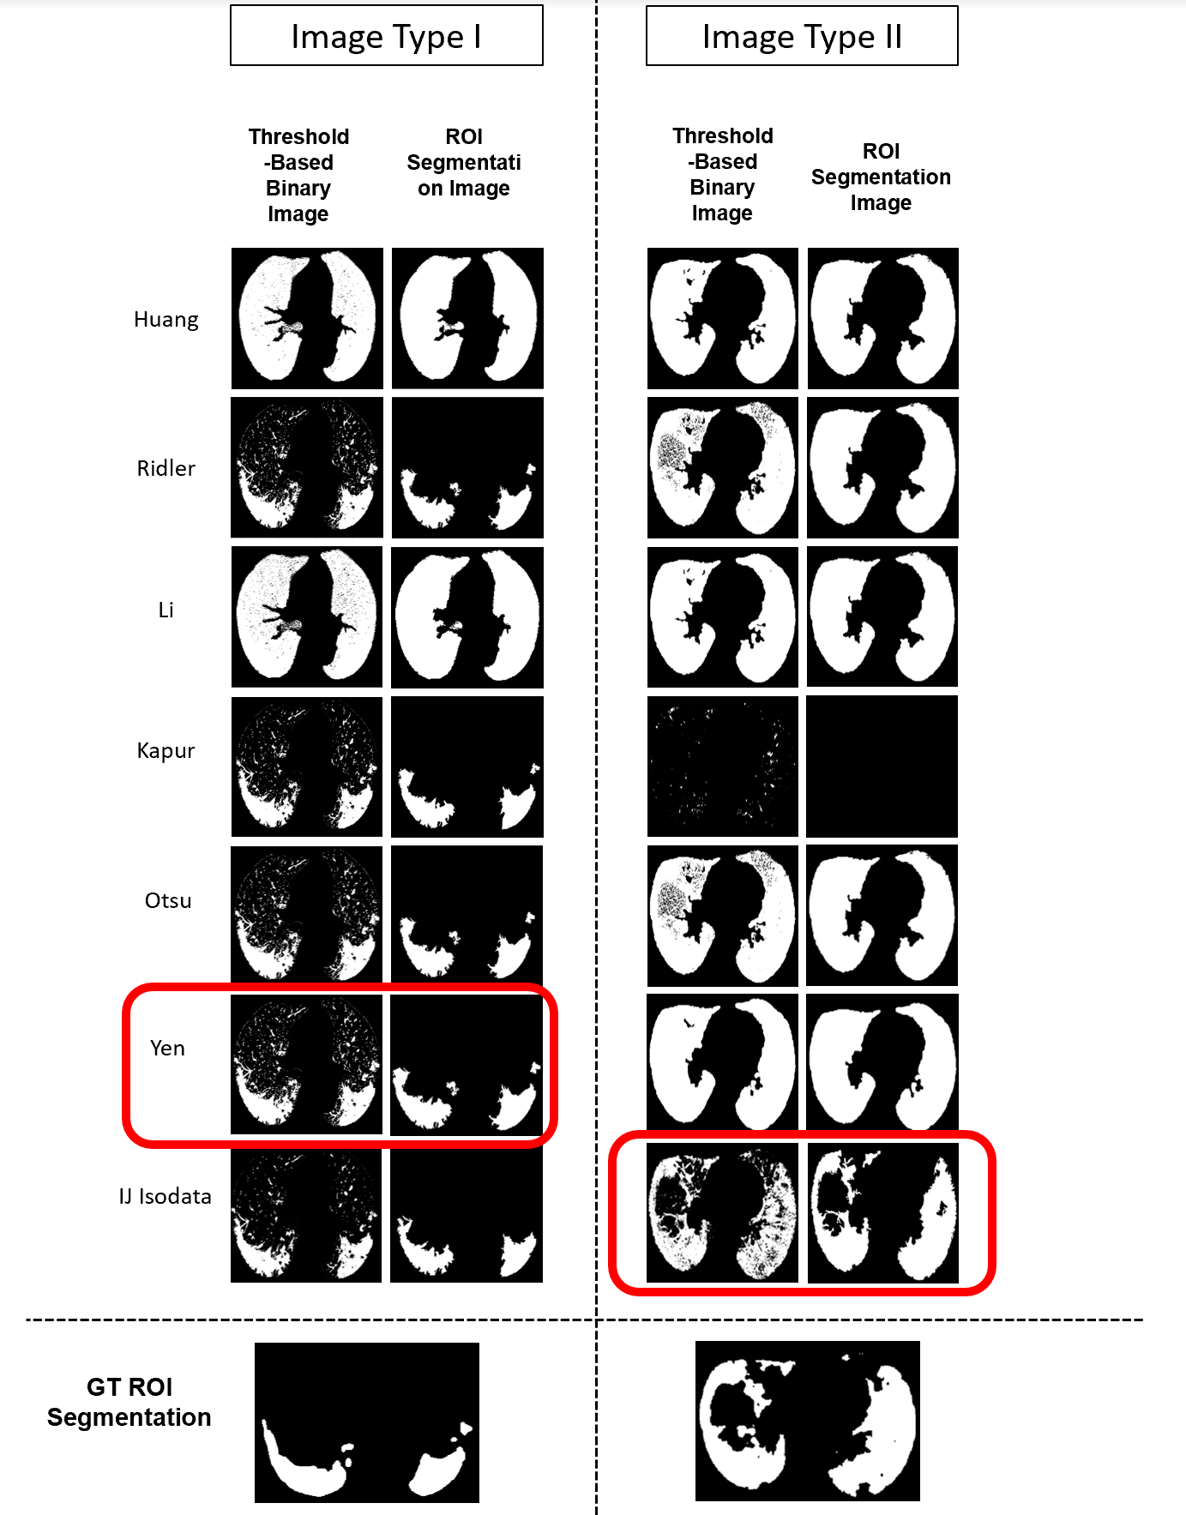
Analyzing thresholding methods

Slide 6
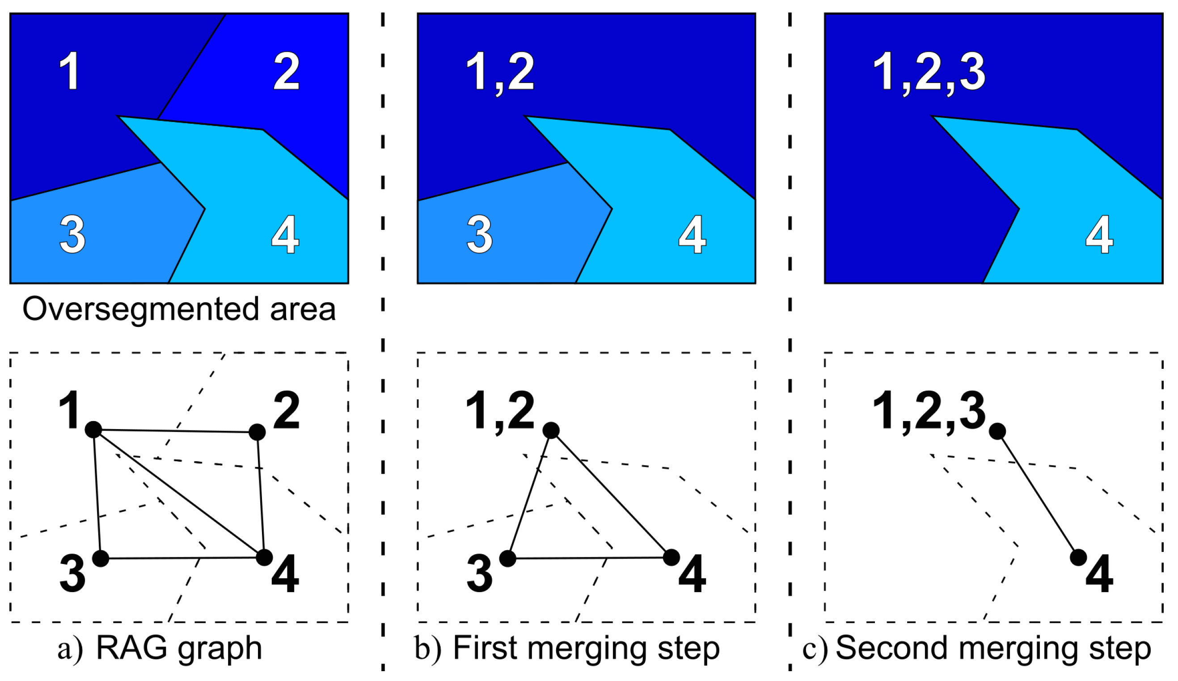
Region Based Method: Region Adjacency Graph
Jaworek-Korjakowska, J., & Kleczek, P. (2018). Region adjacency graph approach for acral melanocytic lesion segmentation. Applied Sciences, 8(9), 1430.

Slide 7
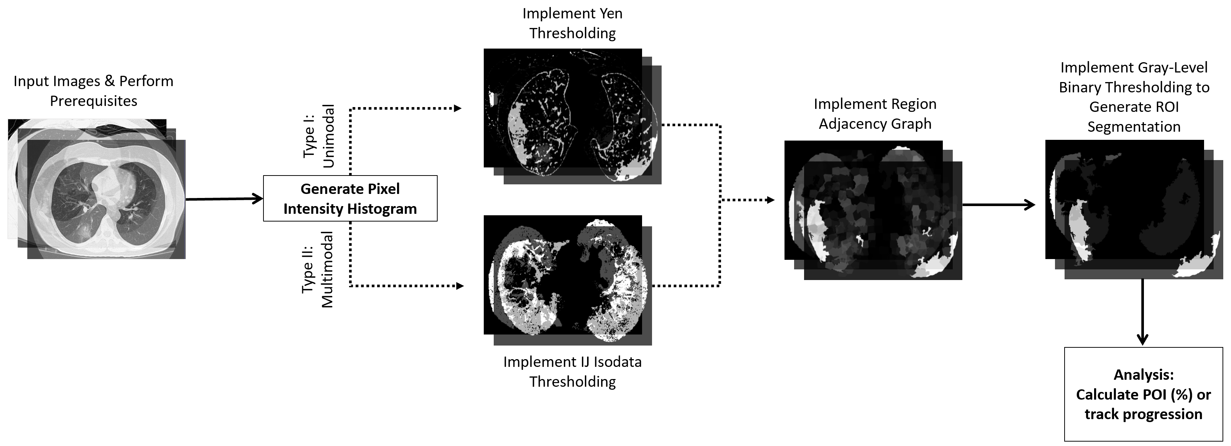
Method
Notes:
Using this we developed our method. First in A, there's a CT scan slice, then extracted lungs from the CT scan, after that we implemented either Yen or IJ Isodata thresholding based on the case, and then region adjacency graph thresholding which merges regions with similar pixel intensities, and we used this method to eliminate the uninfected segmented regions. Finally, we implemented binary thresholding again to calculate infection rate using pixel densities.

Slide 8
Future Development and Acknowledgment
Test method on additional datasets
Add features to classify CTs based on severity: moderate, mild, or severe
Thank You NSF and USC LONI
Notes:
For future development, we are working further validating the method. And I was intereseted in analyzing COVID-19 patients using segmentations because medical image segmentation is an important image processing step in medical image analysis. Also, I've previously worked with image segmentations in another study. That's why I'm analyzing COVID-19 positive patients using segmentations of the infected regions of their lungs.

